Slide 1
Parent School Partnership
Coffee Chat

Slide 2
Core Knowledge

Slide 3
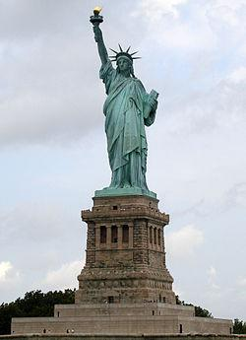
Identify Me!
Notes:
Example of Statue of Liberty
-Ellis Island
-Immigration
- originally designed for the Suez Canal in Egypt
-Originally designed to be a lighthouse
https://www.slideshare.net/Meg122/hirsch-presentation
..

Slide 4
A moment to reflect
How did it feel when you could identify the picture?
How did it feel when you could not?
What benefits might people who can identify the slide have over those who could not?
Notes:
What subject areas were represented?
What were you feeling when you could identify and share knowledge about what the slide represented?
What were you feeling when you could not identify and share knowledge about what the slide represented?
What benefits did those who could identify the slide have vs those who could not?
How might your experience be similar to that of your students?

Slide 5
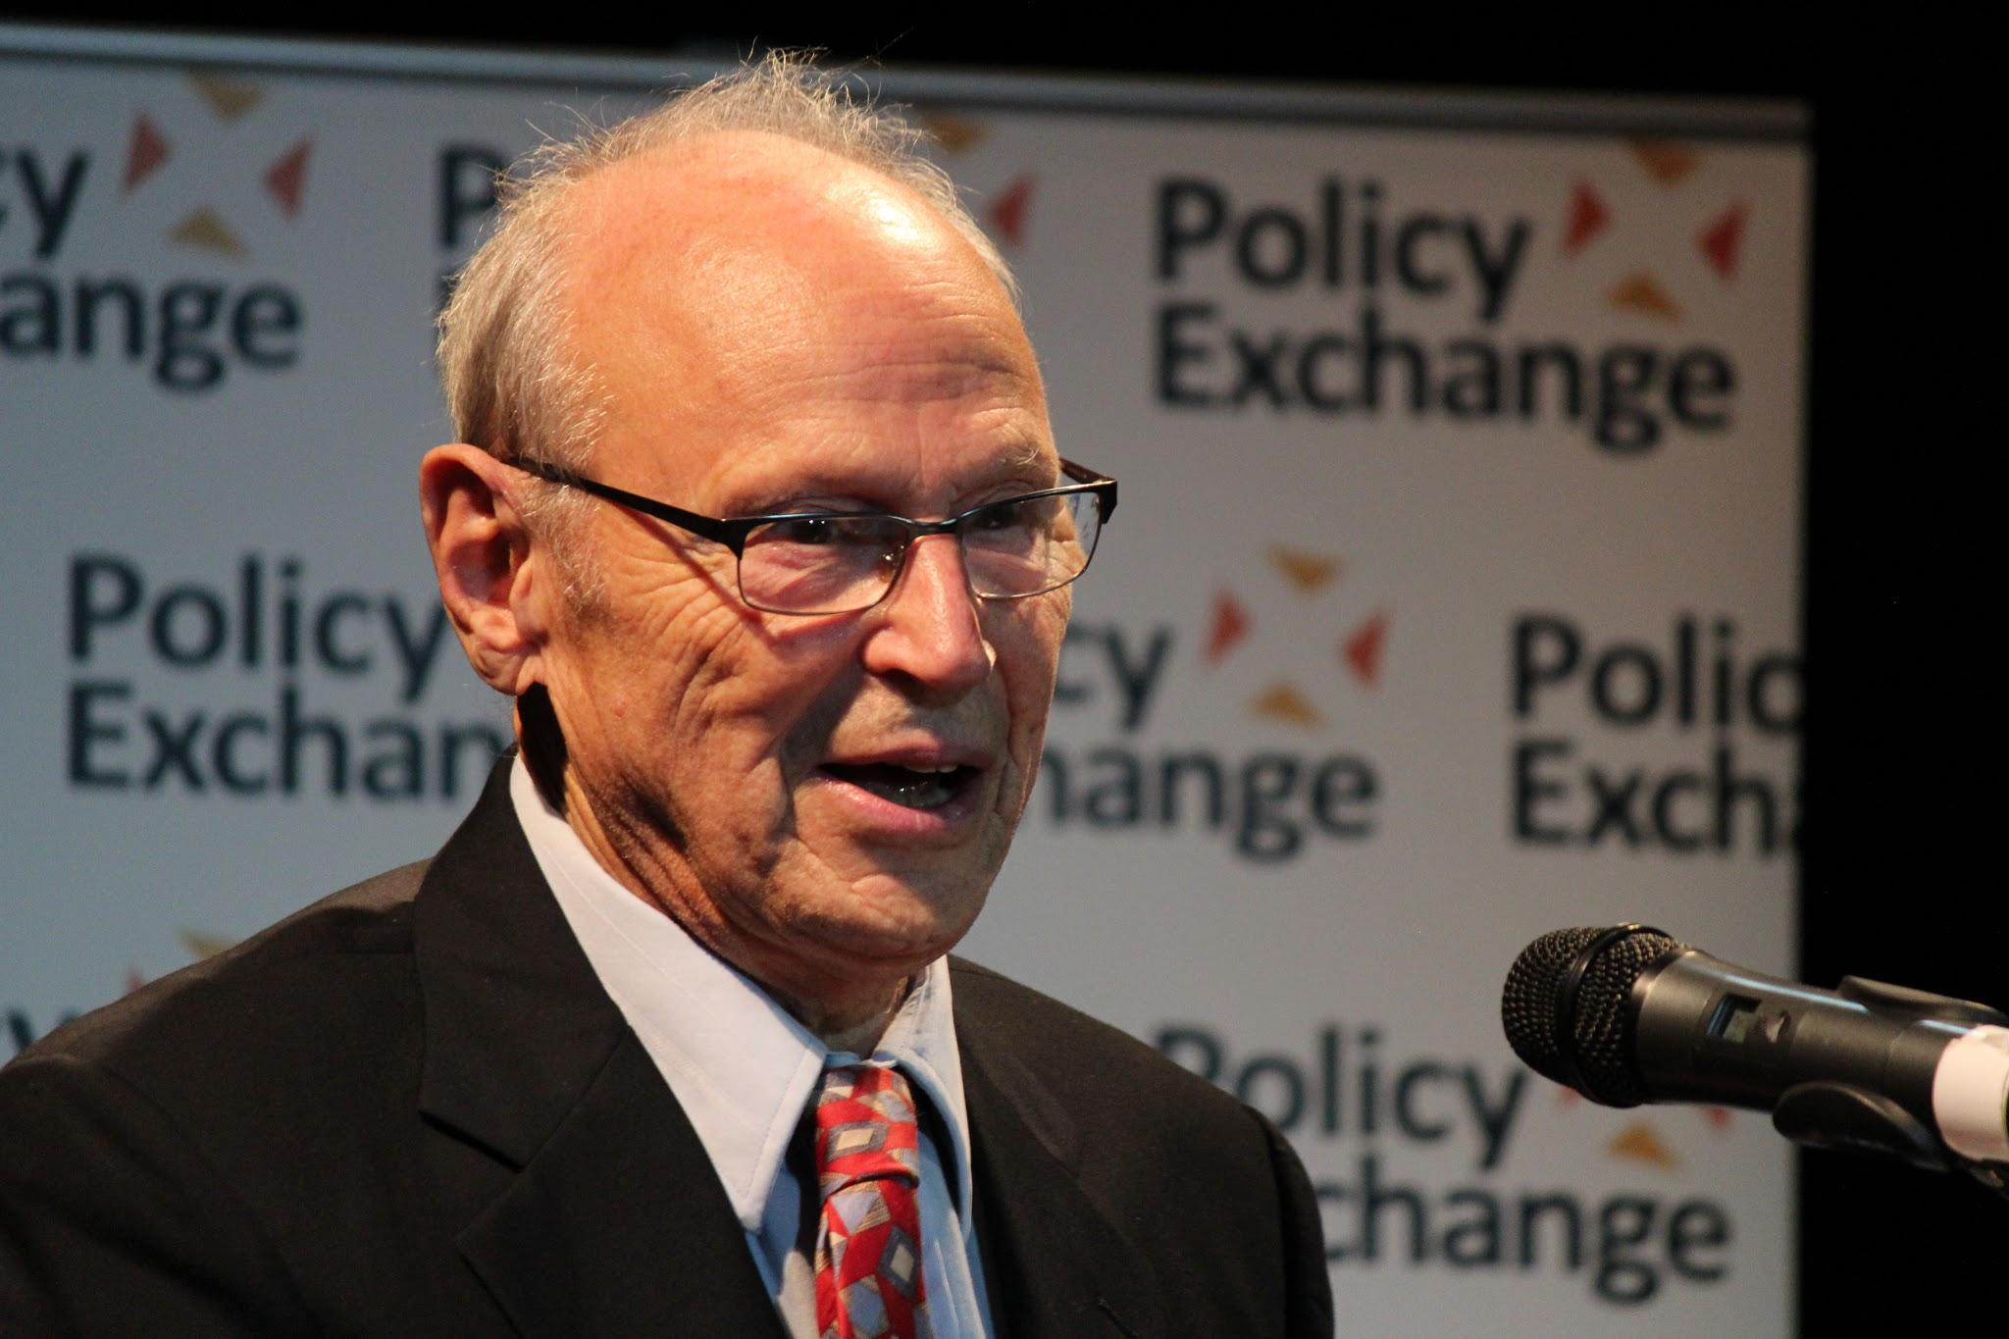
E.D Hirsch Jr
Author of Cultural Literacy: What Every American Needs to Know
5,000 essential names, phrases, dates, and concepts
Led the Core Knowledge Movement: teachers, parents, admin, professors, historians, scientist, multicultural specialist
Core Knowledge Founder and a K-12 Education Reformer
Advocate for closing the achievement gap through an equitable education programs
Close the achievement gap by closing the knowledge gap

Slide 6
THE KNOWLEDGE GAP focuses on a long-overlooked issue lying at the heart of what is known as the achievement gap: the failure of most elementary schools, and especially those serving low-income children, to systematically build knowledge of the world.
Comprehension strategies can be useful–when delivered in limited doses and connected to specific content. But cognitive science has shown that the primary factor in whether you’re able to understand what you read is whether you possess relevant background knowledge and vocabulary.
The prevailing narrow, skills-focused approach to literacy instruction can hold any child back, but its effects fall hardest on those at the bottom of the socioeconomic spectrum. Children from more educated families often absorb knowledge about the world at home. But those from less educated families have to rely on schools for the kind of knowledge that will equip them to do well on tests—not to mention in high school, college, and life. Every year they spend in school without getting that knowledge puts them farther behind their more affluent peers. By the time they get to middle or high school, it’s often too late for them to catch up.

Slide 7
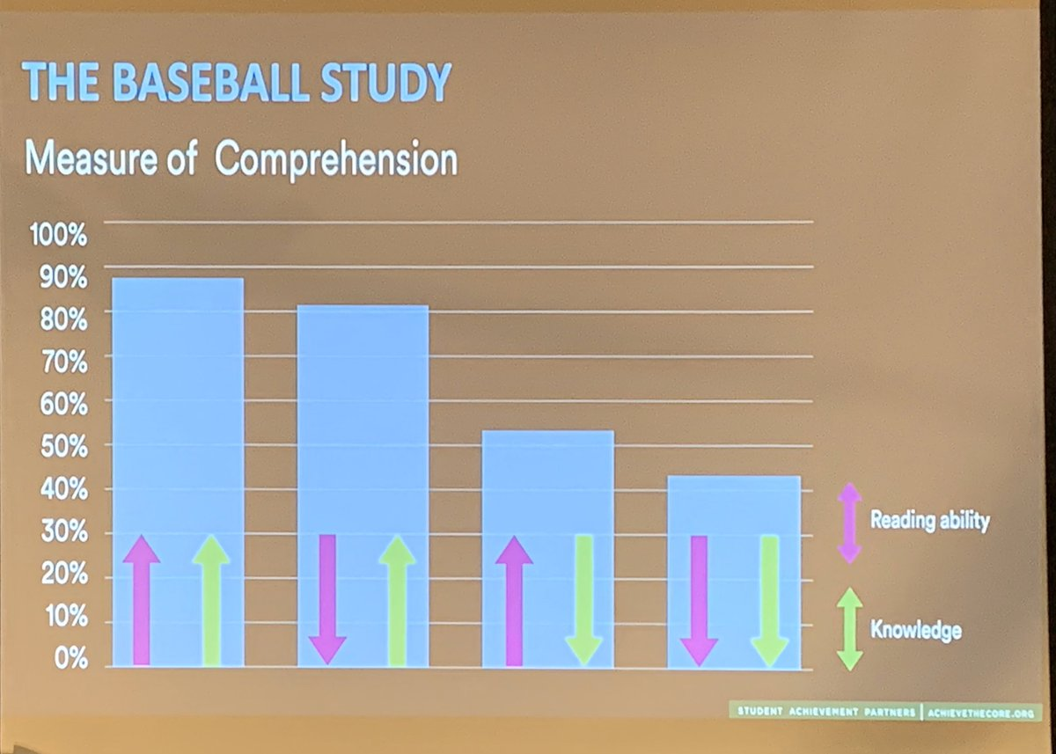
Example:
Baseball Comprehension Study

Slide 8
What is Core Knowledge?
Gives stakeholders access to the curriculum
Tool for equity
Respects Diversity

Slide 9
Bringing Core Knowledge into the Home
Opportunities to Extend Learning
Use PBS’s search engine to find free documentaries and clips aligned to content
Read the “Grader” Book as a family
You can find a copy at our school book swap
You can purchase a copy from the Core Knowledge Store
Take ‘virtual tours’ using the resources on thehistorylist.com or search for specific museum websites. Many have built opportunities for distance learning that allows families to engage from afar.

Slide 10
Use the Core Knowledge sequence to help you frame specific and meaningful questions that spark family discussions.
Example:
Ask This… | Not This… | Here’s Why
I know your class is learning about Mesopotamia. What are you talking about when you discuss Mesopotamia? | What are you learning about in history? | It is powerful to let our children know that we have a strong connection to their school and their education. When we ask questions about what they are learning, it is because we are interested in having deep, meaningful conversations.
I remember learning something about rivers and ancient civilizations. What have you been discussing in class related to rivers in ancient Mesopotamia? | What are the two rivers in ancient Mesopotamia? | We want to ask questions that can be answered in many ways and don’t necessarily have a right or wrong answer. We are not quizzing our child, we are attempting to spark a conversation

Slide 11
How are you, or how can you bring Core Knowledge into your home?

Slide 12
Parent School Partnership
Coffee Chat

Slide 13
Parent School Partnership Board of Representatives
Kay Bass, co-lead
Krystl Burleigh, co-lead
Kiran Sibia, treasurer
Julie Ervin
Ande Shultz
Nicole Pinkston
Angela Wimsatt
Mayra Martinez-Aguayo
PSP Board of Representatives works with the school to utilize AGC funds to support family engagement, student enrichment, and campus enhancement.
www.GatewayPSP.org
Notes:
We are a volunteer group of parents, family members, & community supporters who partner with the Gateway team to work to enhance campus community, provide school support, and help enrich our students’ collective experience.

Slide 14
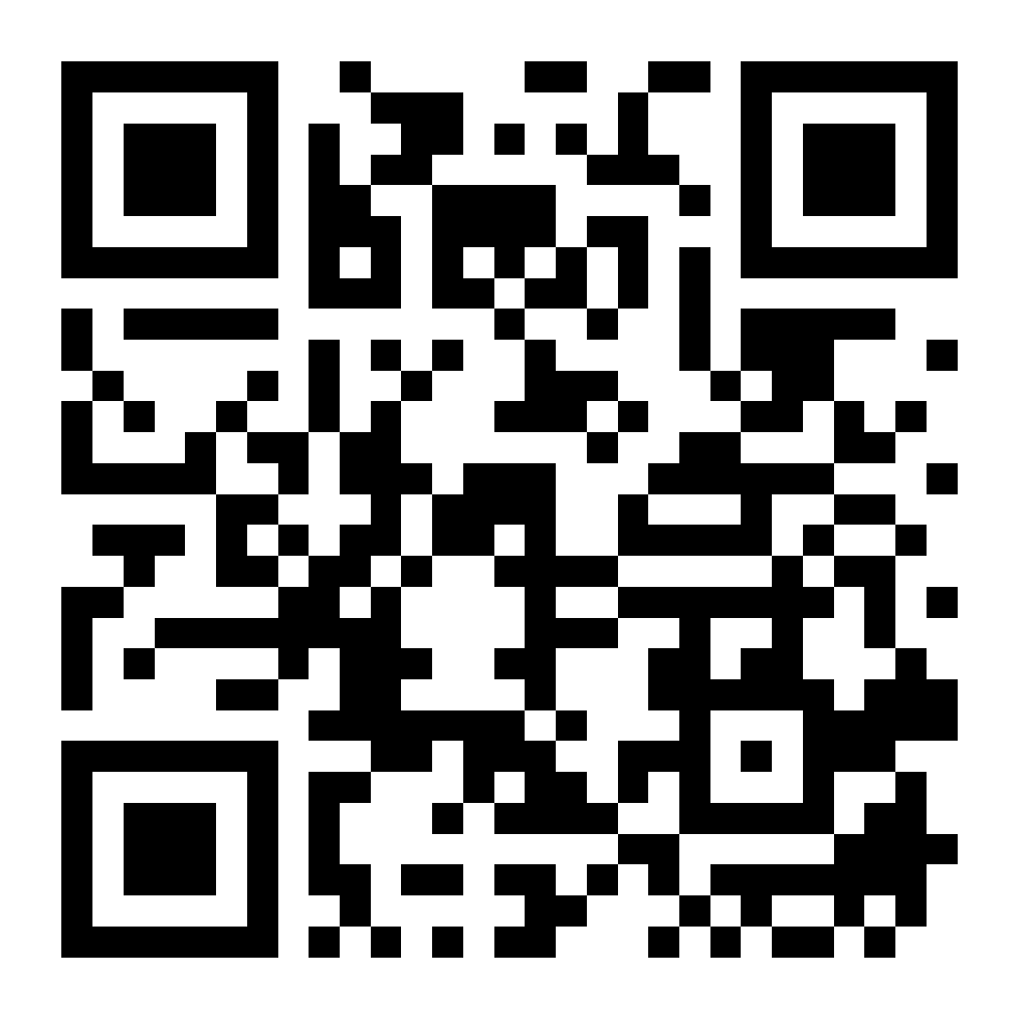
Join the team
Chat with us today or set up another meeting to learn more!
Email GatewayPSP@rafos.org for the electronic application
Become a PSP representative today to help with event planning, family connection, and campus enhancement!
More info at GatewayPSP.org

Slide 15
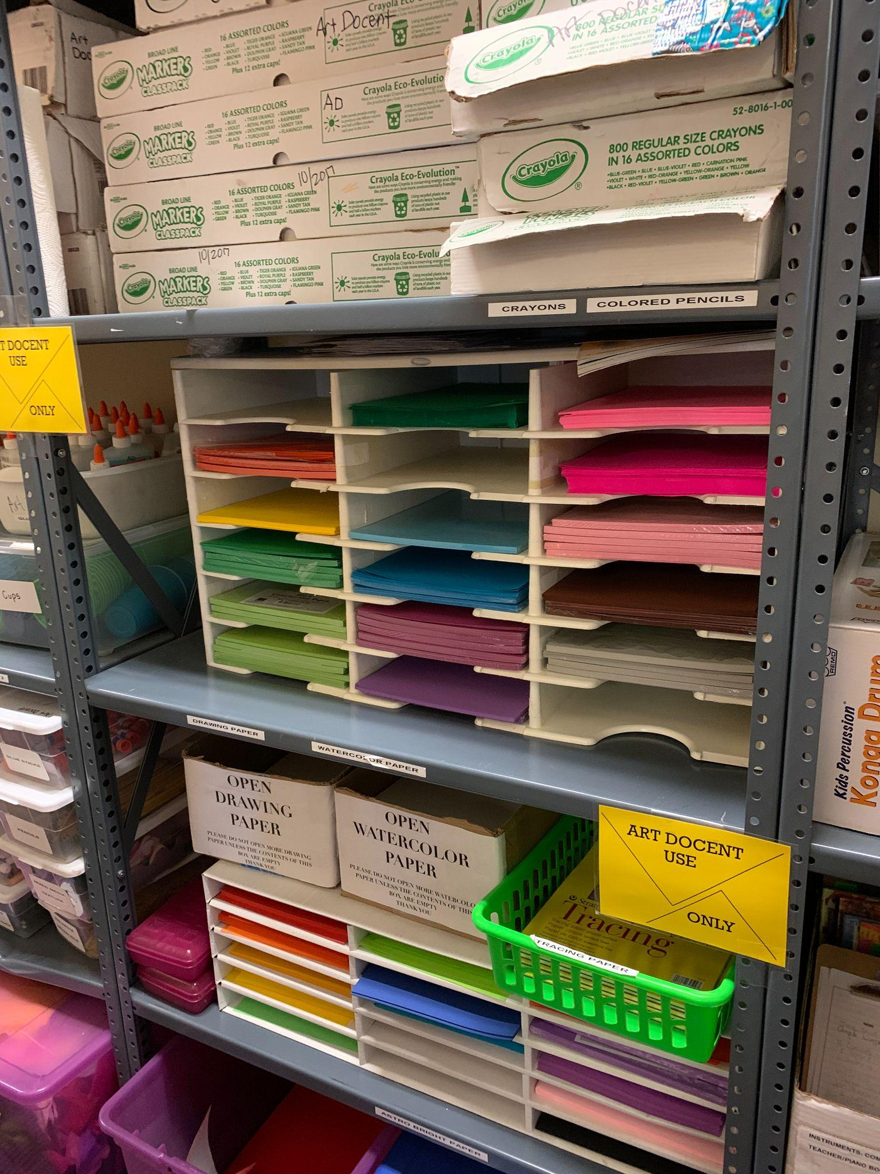
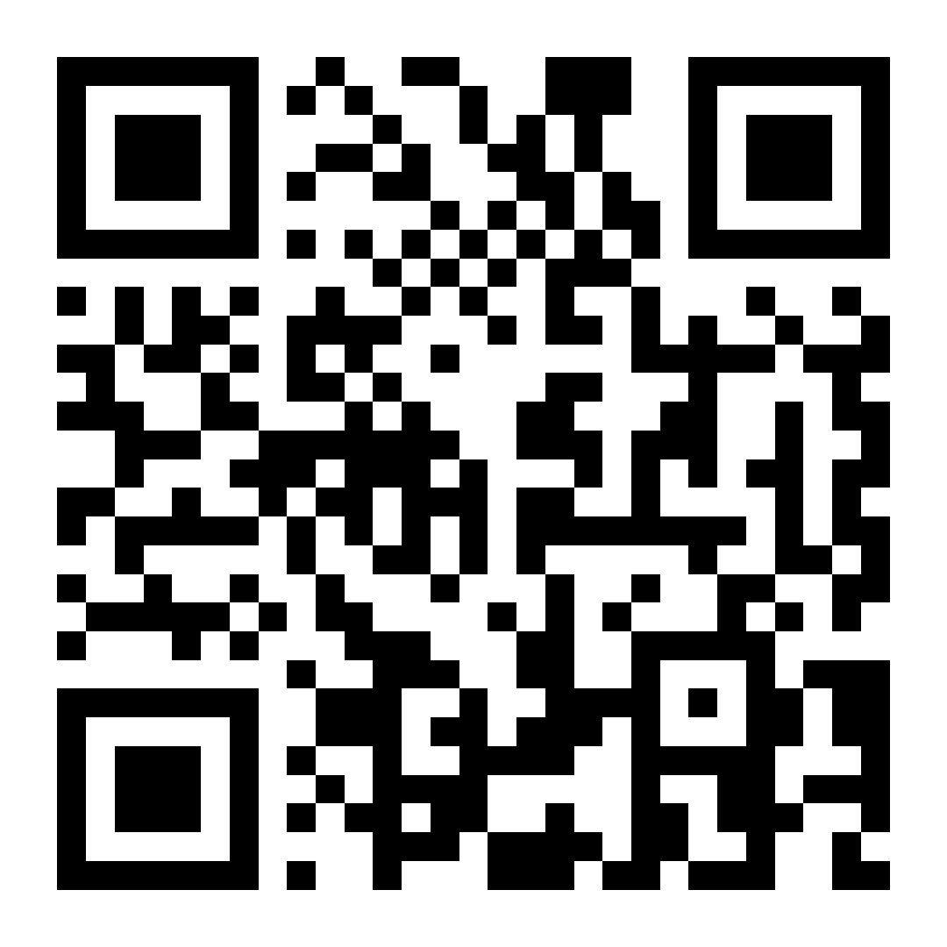
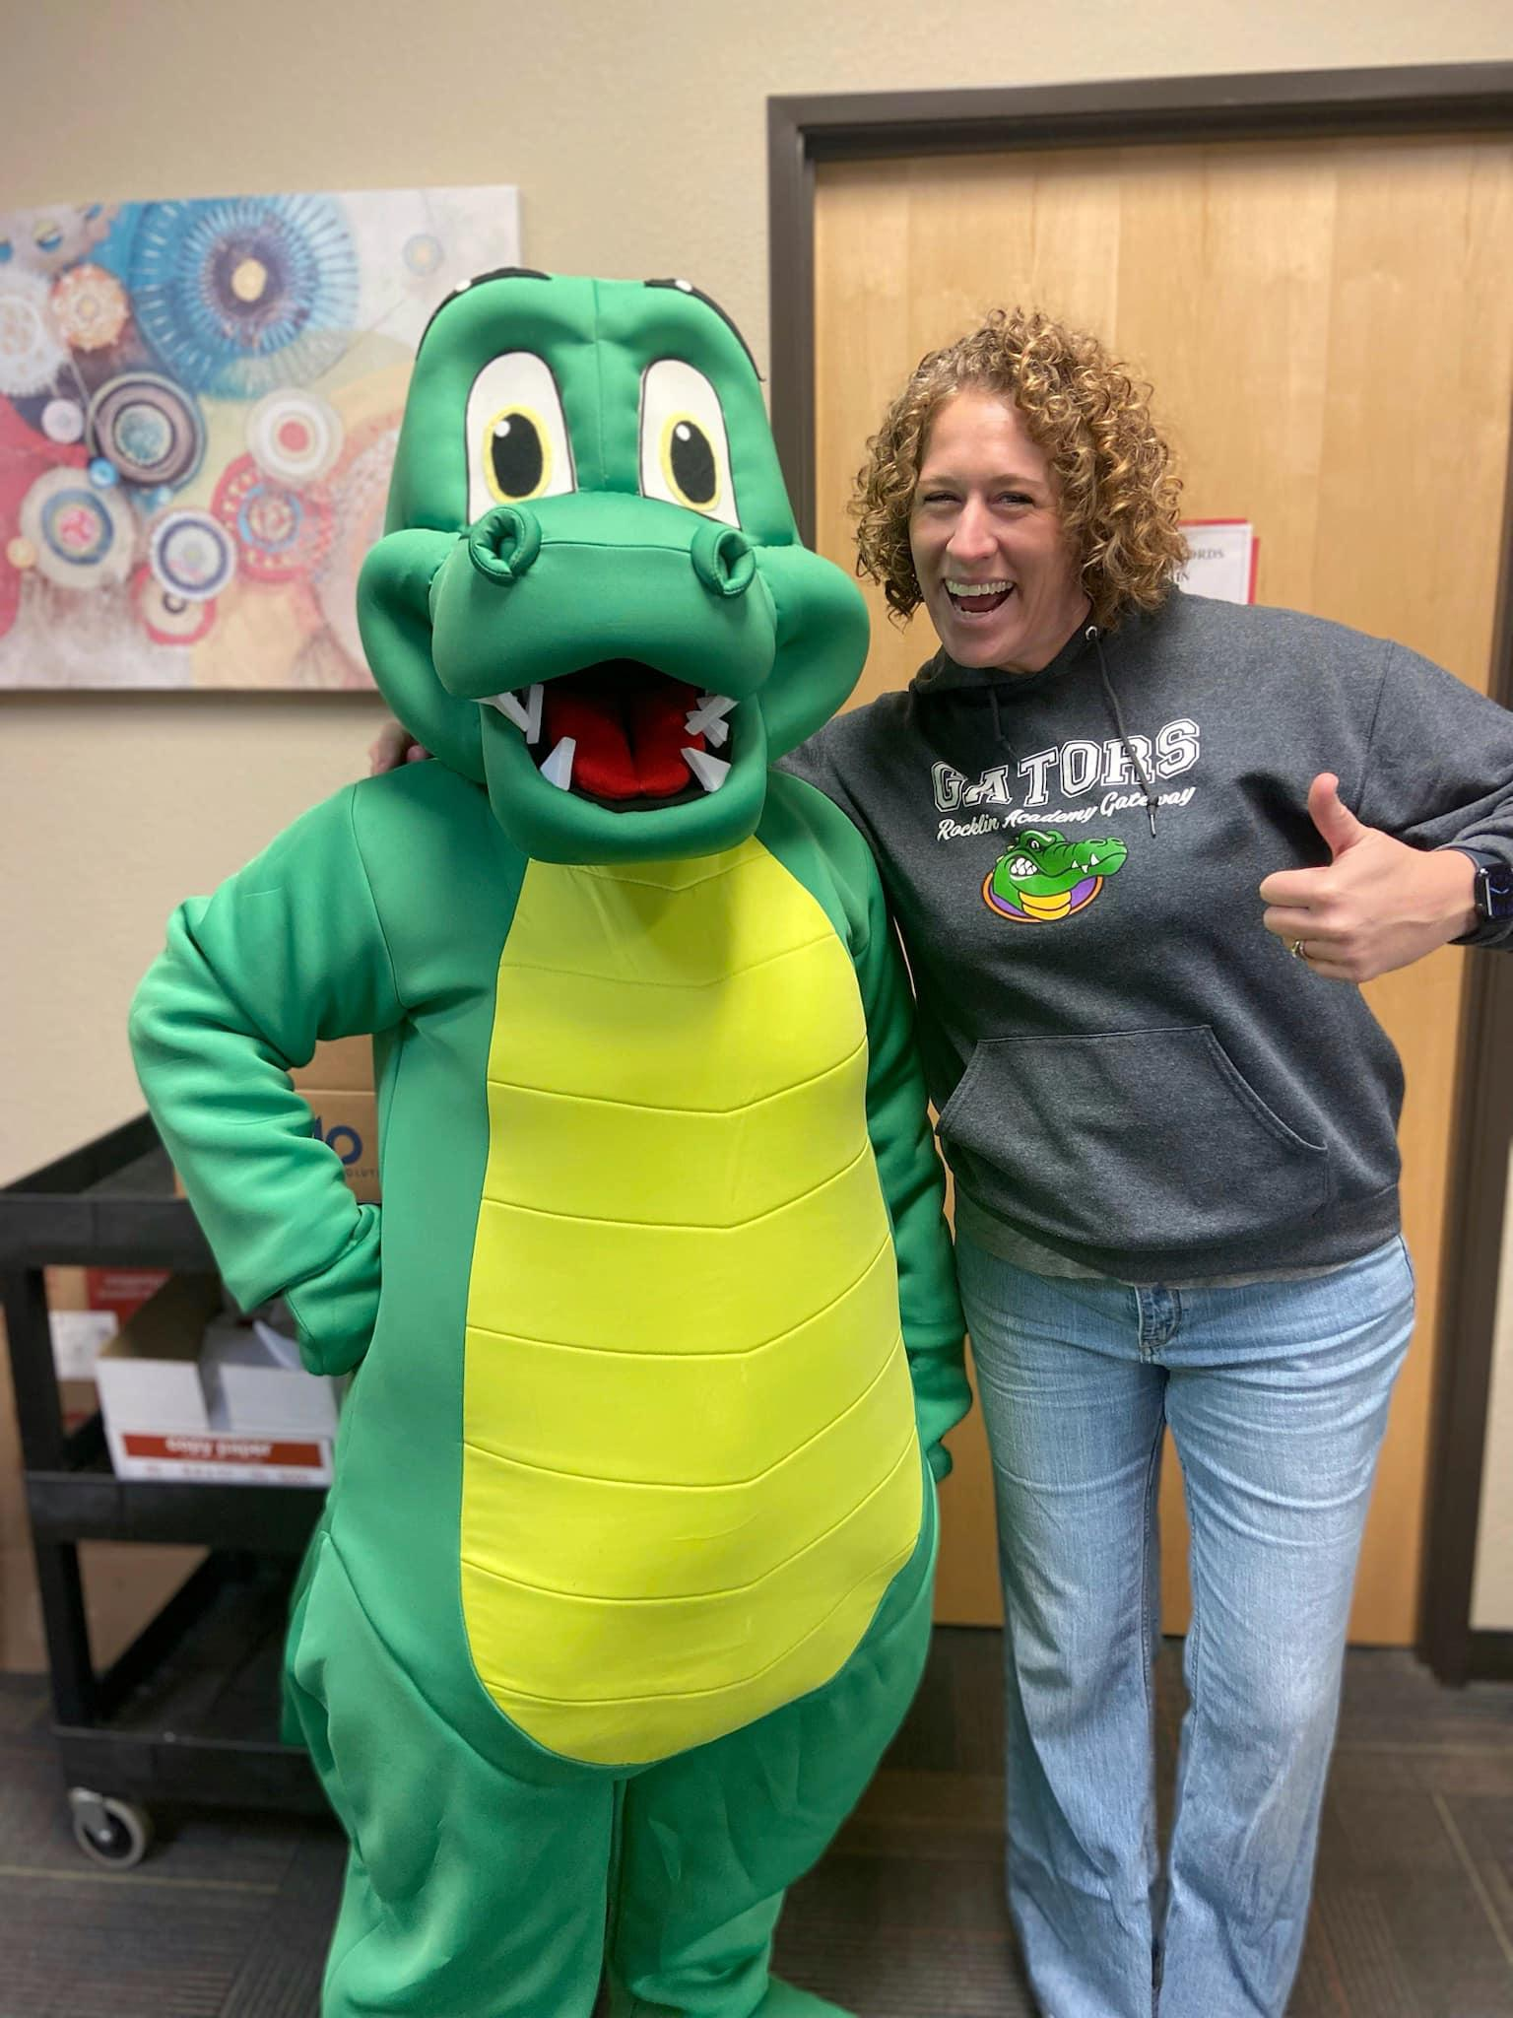
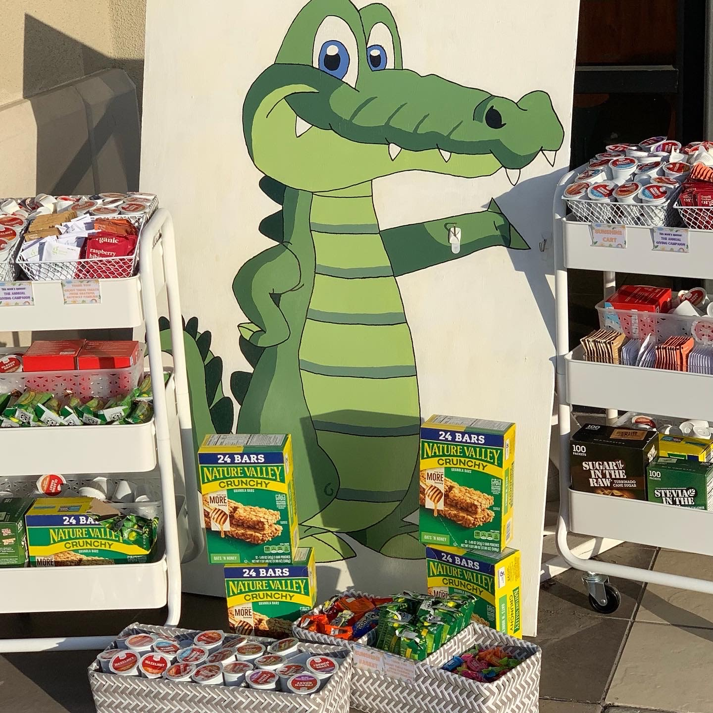
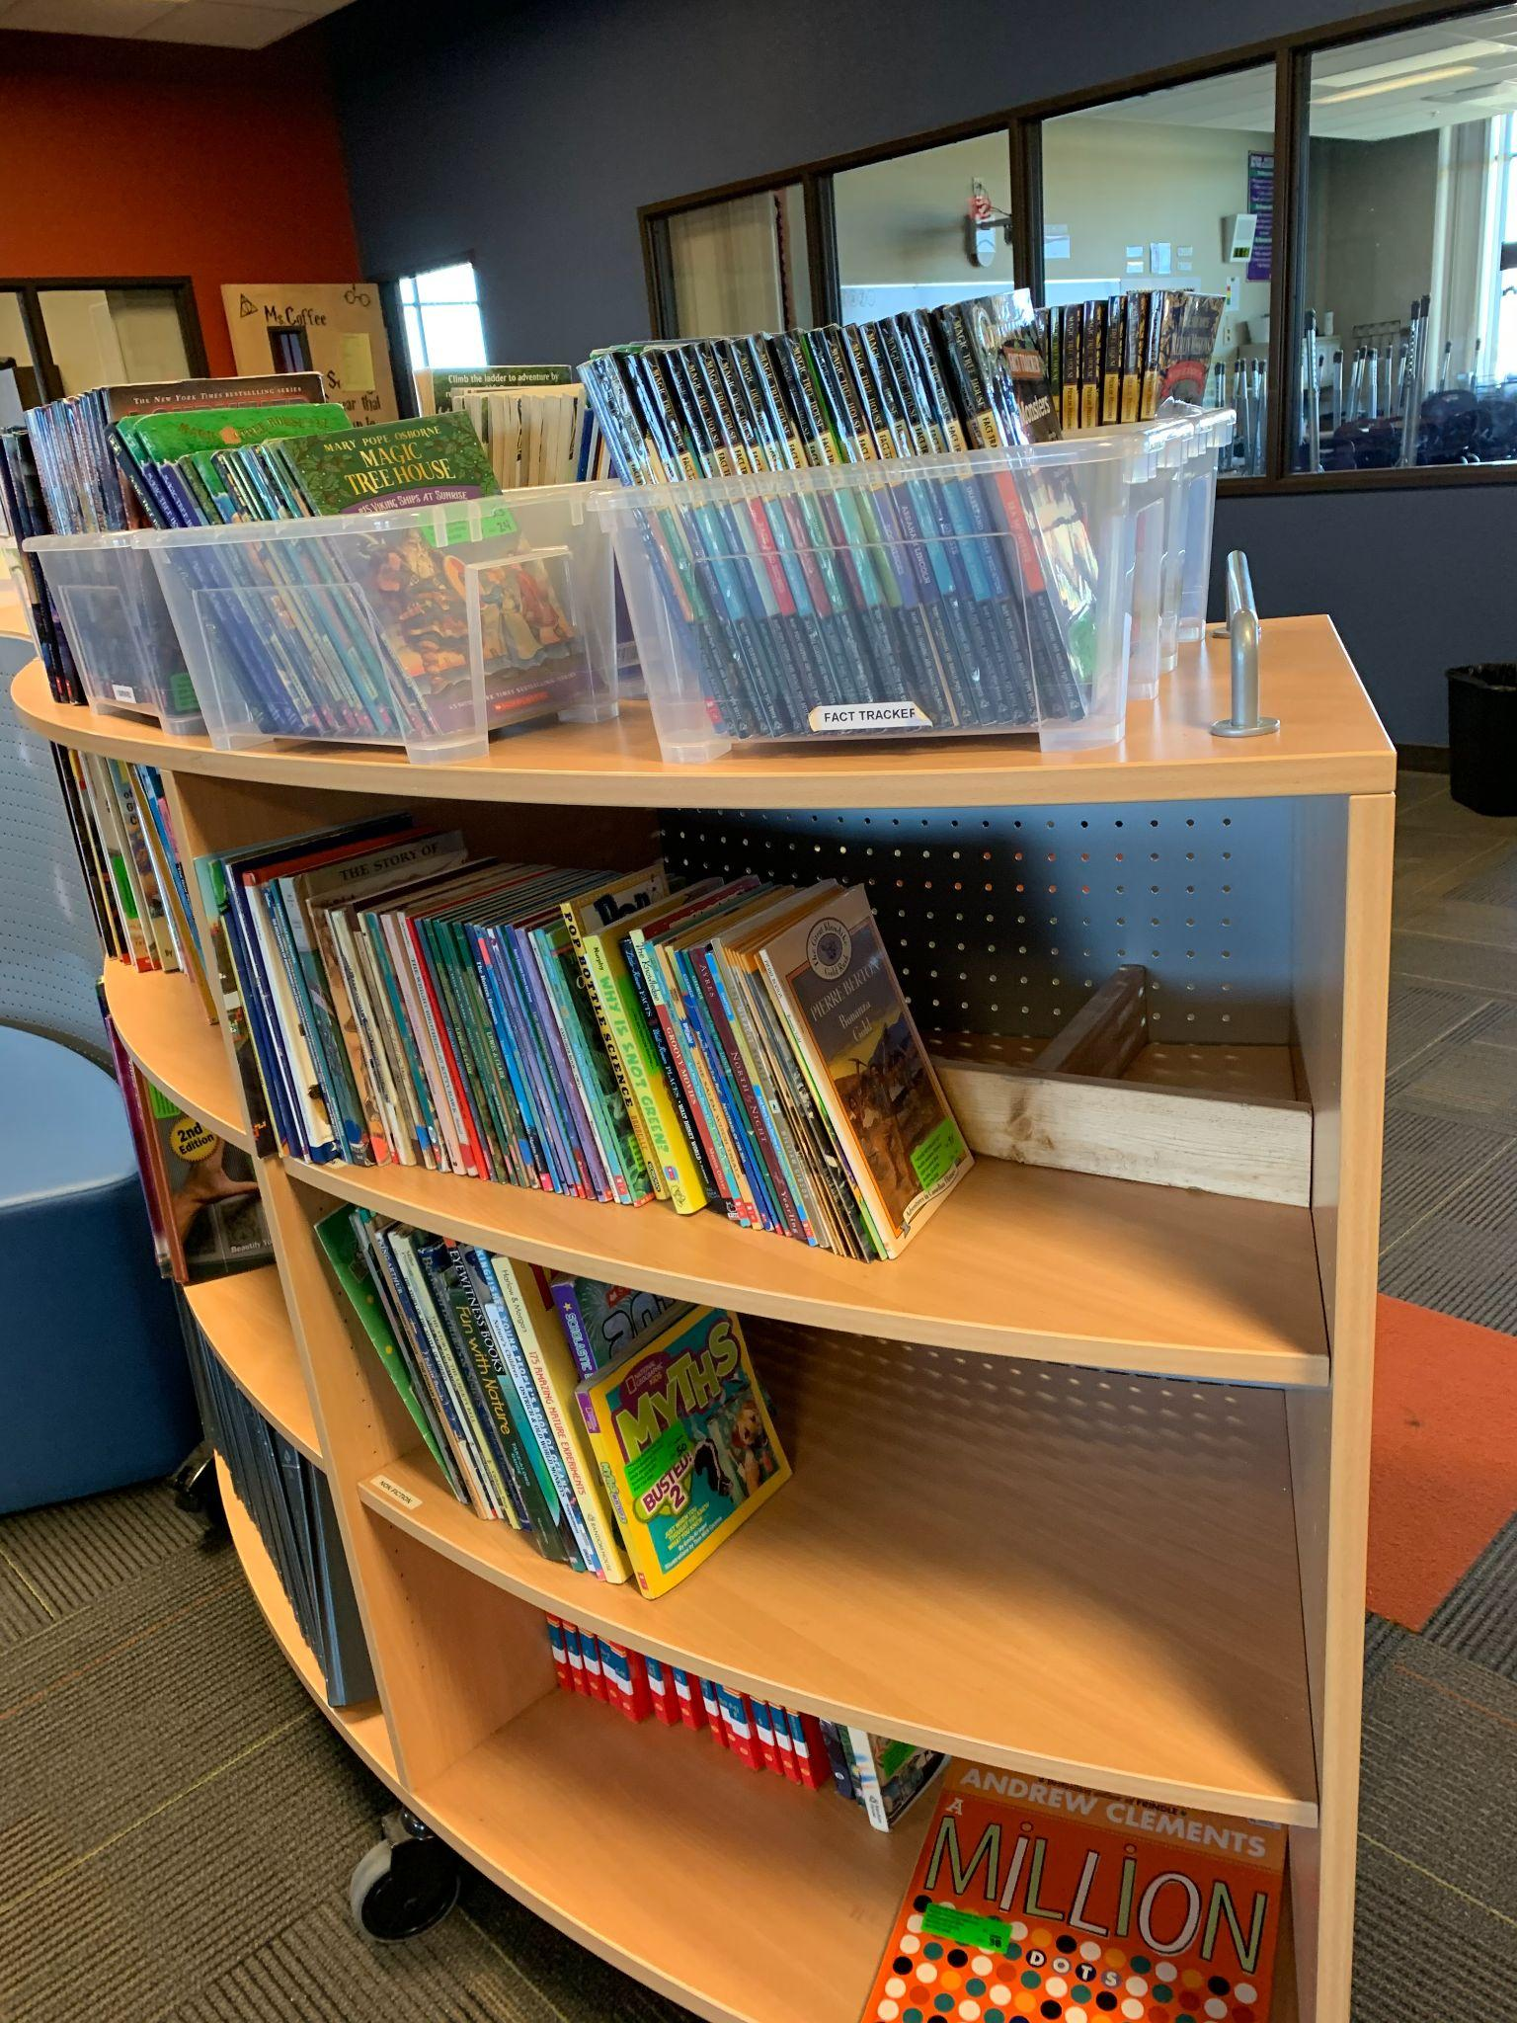
What is the AGC?
2022-2023 AGC link
The Annual Giving Campaign serves as the heart of our largest fundraiser. These funds are critical to bridge the gap and assist in providing students with everything that is not covered in our annual school budget.
Without continued support from our families these amazing programs, projects, and events would not be possible.
THANK YOU FOR YOUR SUPPORT!
22-23 AGC: https://gatewaypsp.rallyup.com/agc2223
Notes:
AGC fundraising directly supports our students in many vital ways including:
Campus Beautification Projects (EX: water bottle filling stations)
Classroom Accounts
Upkeep of the Hub libraries
Music and art docent instruments and supplies
Staff Appreciation gifts
Entertaining events throughout the year such as the upcoming Trunk or Treat and Middle School Dance

Slide 16
Treasurer Report
AGC: $22,319 AGC (17%)
Current bank balance: $46,000
Fundraisers since last meeting
Skipolini’s = $0 raised
Smashburger = $208.73
Barnes & Noble =
Full report posted on GatewayPSP.org

Slide 17
Upcoming Events
2/13: *JUST ADDED* Marco’s Pizza fundraiser
3/9: Virtual PSP meeting to review LCAP
3/9: Skipolini’s fundraiser
3/13-3/17: Scholastic Book Fair
3/15: Coffee Chat
3/17: International Festival
4/16: Silent Auction
Join your Gateway community at these upcoming events!
More info at GatewayPSP.org

Slide 18
Gateway’s First International Festival: Friday, March 17th, 6-9 pm
We are hosting our first ever International Festival. This free event will showcase exhibits, performances, and ethnic cuisine. Come and learn about the various communities represented by our families at Gateway. Tickets for this event will be released in the next couple of weeks.
We are still looking for performers and exhibitors. Go to the links on the PSP site for more information. Spaces are filling up quickly!
Notes:
Tickets allow for enough candy and food!

Slide 19
Silent Auction
Mark your calendars for our 2nd Annual adults only, in person Auction at Top Golf. This amazing event will be held on Sunday, April 16th, 2023!
We currently have Sponsorship Opportunities available! See flyer in the Gator Gazette & on the PSP website for details!
Also -- Keep an eye out for next week's Gazette for the link/QR code to purchase pre-sale tickets! Save $10/ticket by purchasing early!
Sunday, April 16th
@ TopGolf
More info on GatewayPSP.org
Notes:
Tickets allow for enough candy and food!

Slide 20
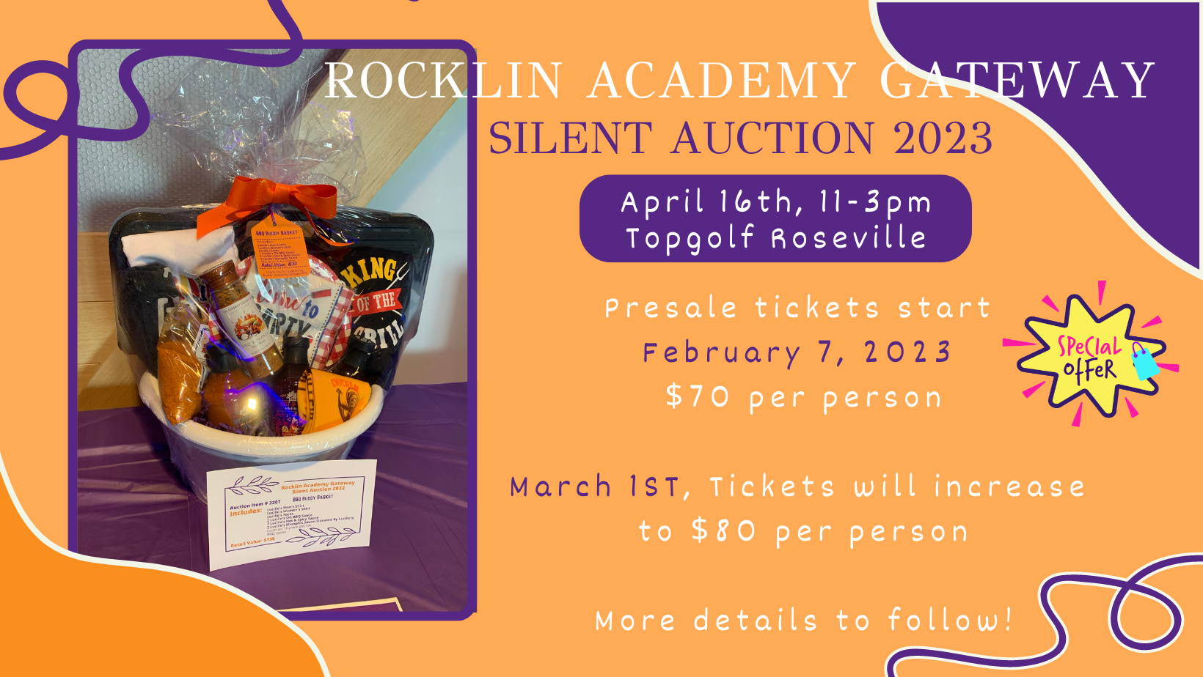

Slide 21
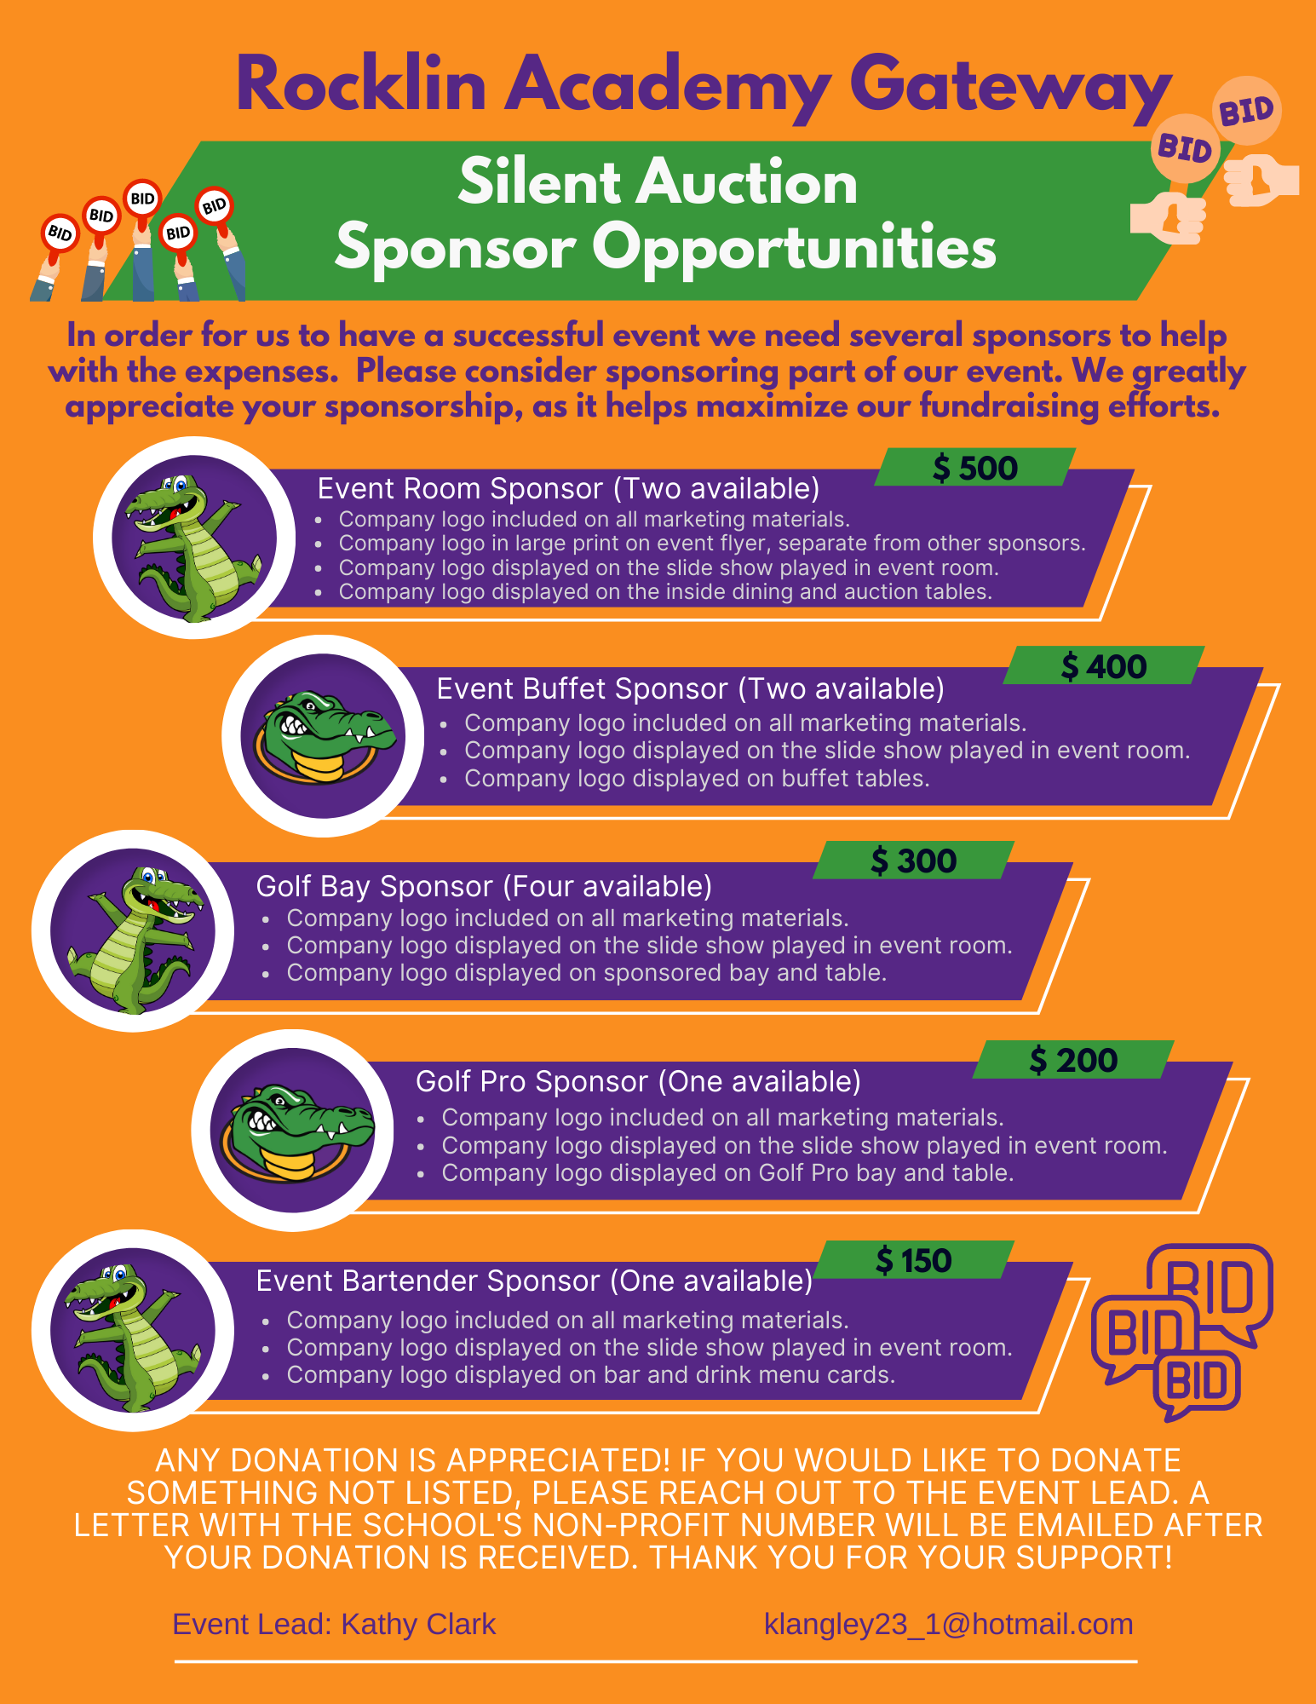

Slide 23
Immediate Needs
Contribute to the Annual Giving Campaign
Join the Fundraising Committee
Class baskets for the Silent Auction
Volunteer Opportunities:
International Festival
Scholastic Book Fair
How can you help out today?
More info at GatewayPSP.org

Slide 24
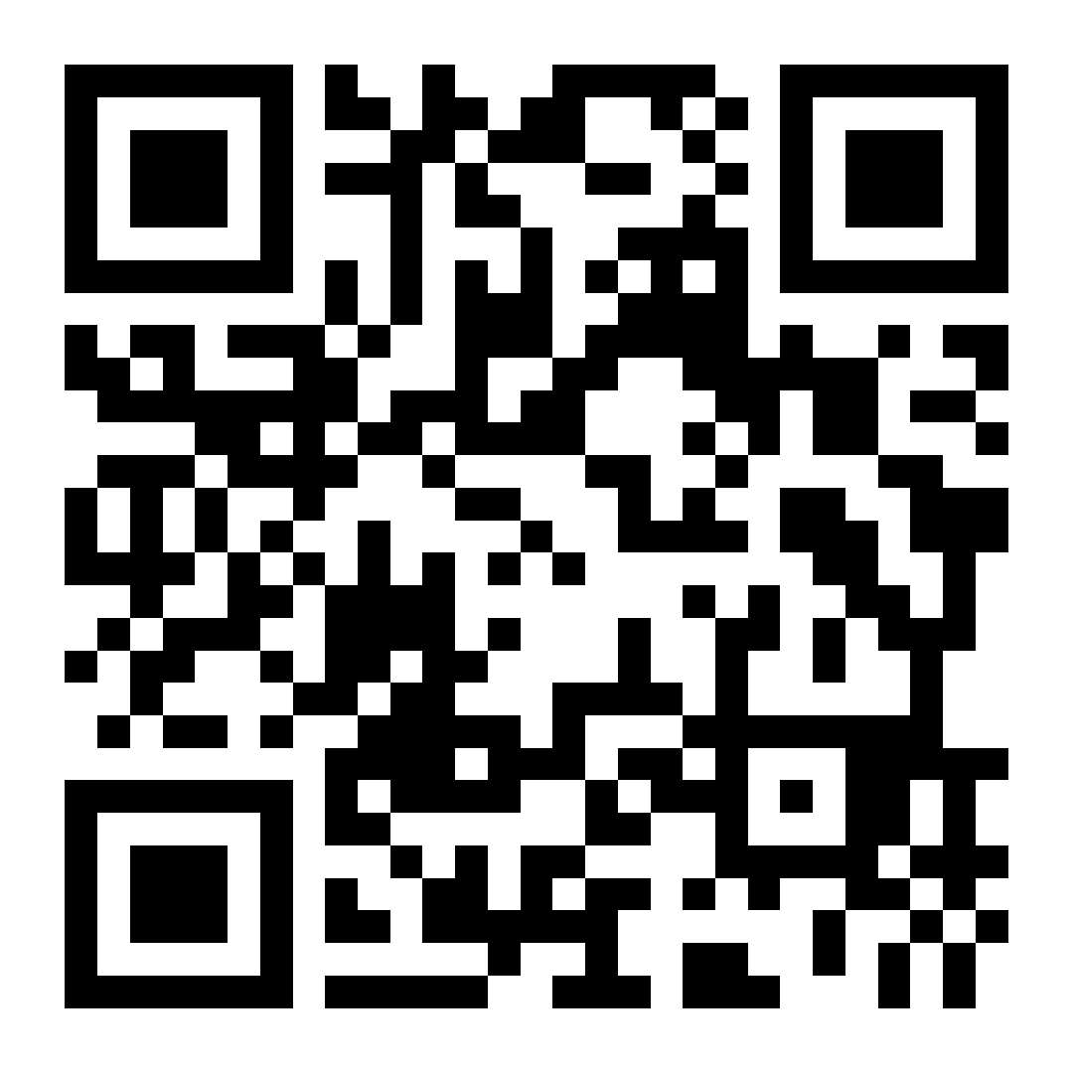
Keep in touch
Website: GatewayPSP.org
Email: GatewayPSP@rafos.org
Instagram: @RAGatewayPSP
Facebook.com/RAGatewayPSP
And don’t forget to sign up or update your listing in the family directory on our website!
www.GatewayPSP.org

